Slide 1
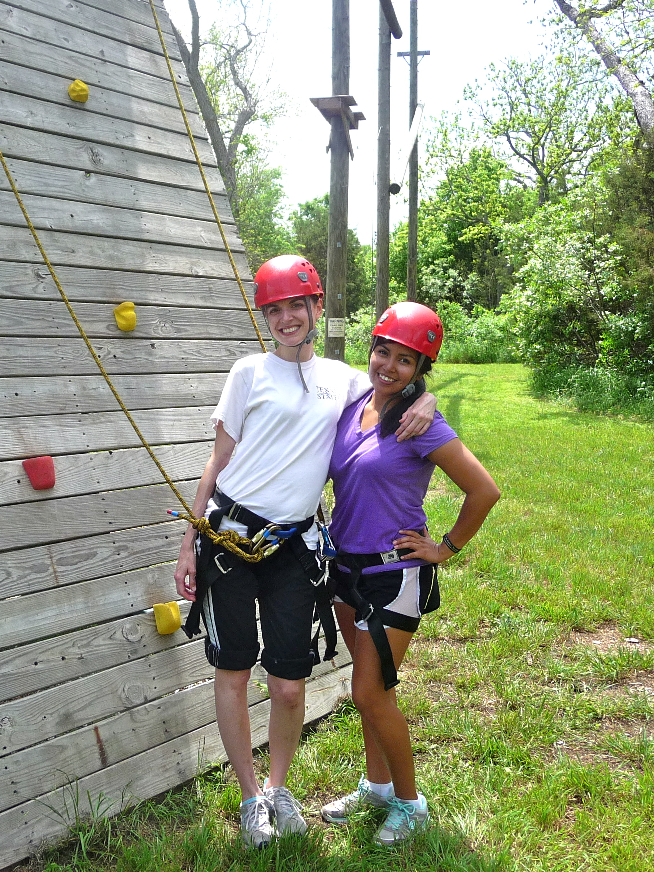
Foster Care Alumni (FCA) in Higher Education: The Potential of a Strengths Framework

Slide 2
Outline
Strengths Perspective
What is it?
How can it be incorporated into a support program?
Assessing the benefits of a strengths perspective
A demonstration

Slide 3
A Strengths Perspective: focuses on what is “right” with people rather than on what is wrong. It identifies, builds upon, and amplifies people’s strengths, resilience, and resources. While it recognizes and acknowledges people’s problems (such as mental illness, physical disability, poverty, legal troubles), the strengths perspective views these as challenges and as needs to be addressed, not as deficits, pathologies, or character flaws.

Slide 4
Evidence
Supported by research from many fields:
Social Work-Strengths
Sociology-Self-fulfilling prophecy/Social construction of reality
Biology-Placebo effect
Psychology-Positive
“If men define situations to be real, they are real in their consequences.”
-W.I. Thomas

Slide 5
Inspiration
Man is his own star; and the soul that can Render an honest and a perfect man, Commands all light, all influence, all fate; Nothing to him falls early or too late. Our acts our angels are, or good or ill, Our fatal shadows that walk by us still.”
~ Emerson

Slide 6
Challenges
What does it look like in practice?
Does it make a difference?

Slide 7
Practice Guidelines
Develop roster of resources and assets
Celebrate lessons and successes
Seek out survivor’s pride
Dream for and imagine the future
Think small but think success
Seek out and employ the client’s theory of success
Look around, look ahead, but not back
Saleebey, D. (2000). Power in the People: Strengths and Hope. Advances in Social Work, 1(2), 127-136.

Slide 8
FACES Program Components
Faculty Program Coordinator*
3 SW Graduate Students-Advocates*
Title V PACE/MAC Partnership (Book Lending Library)
FACES Liaison (PACE/MAC)**
Student Support Services: VPSA
Trained Mentors
FACES student organization
Foster Care Advisory Council
Special Events: Mentor/mentee; FACES student group, etc.
Research/Evaluation***
*Formerly supported by TG Public Benefit Grant, the Center for Children and Families and the SSW. Currently supported by Title V Dept. of Education HSI Grant.
**Supported by Title V Dept. of Education HSI Grant.
**Formerly supported by TG Public Benefit Grant and the Sociology Department.

Slide 9
Program Coordinator
Coordinate with VPSA on student support services
Supervise MSW interns
Serve as Faculty Advisor for FACES student org
Foster Care Advisory Council Chair
Trainings: On campus/community
Mentor
1 course release (grant funded)

Slide 10
FACES Advocates: MSW Interns
Recruitment
Community work groups/events
Campus visits: Bobcat Days
Student panels
Retention
Provide individual support to FCA and mentors (!)
Support FACES student organization
Events
Resources/referrals on campus/community
Foster Care Advisory Council
Research and Evaluation
Graduation and Beyond
Financial literacy event
Career Services
End of Year Awards and Recognition Banquet

Slide 11
Student Support Services: VPSA
Mentoring
Training
Matching
Recruitment
Community work groups
Campus visits: Bobcat Days
Outreach
Retention, Graduation and Beyond
Collaborate with FACES Advocates
Early Alerts
Events: Welcome events, mentor/mentee events, financial literacy, finals survival packets, awards and recognition banquet

Slide 12
Mentoring
Recruited by VPSA
Special training: Casey, CPS, etc.
Support from Advocates
Events
Benefits and Challenges

Slide 13
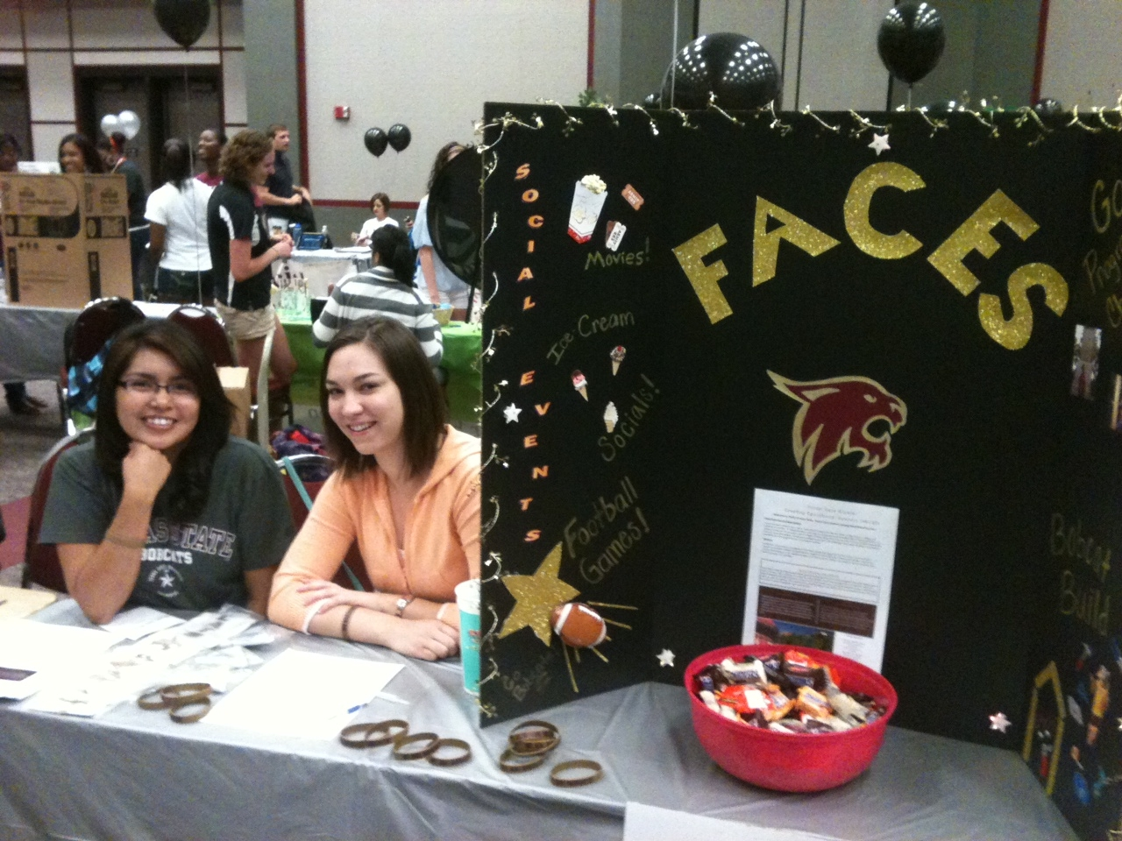
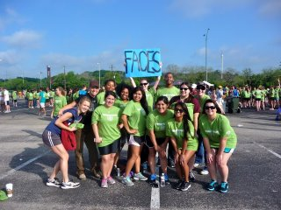
FACES Student Organization
Creating Community and Social Connectedness!
Officers
Monthly meetings
Events
FB page

Slide 14
Foster Care Advisory Council
Creating a campus-wide network of support...
VPSA
Social Work
Sociology
Title V PACE/MAC
Center for Children and Families
Housing and Residence Life
Student Health Center
Counseling Center
Admissions
Financial Aid
PACE
Student Business Office
Student Learning and Assistance Center
Office of Multicultural Student Affairs
Office of Disability Services
Office of Community Relations
P-16 Initiative
Staff Attorney
CASA, Lifeworks, TCCWB

Slide 15
FACES-Incorporating a Strengths Perspective
Coordinator and Advocates Trained in a Strengths Perspective
Already succeeded, here to celebrate and continue success
“Smooth seas do not good sailors make.”
FACES students involved in program design
Selected the name
Initial Advocate was FCA
Student group
Program activities designed to identify strengths
Ropes Course/Retreat
Community Service/Community Outreach
Student accomplishments (large and small) formally recognized
Newsletter (no longer)
Facebook page
Awards Event

Slide 16
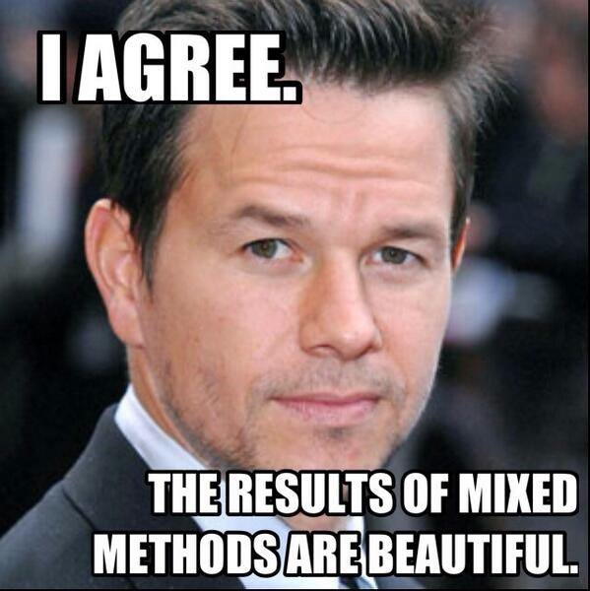
Evaluating a Strengths Perspective
Data
Field Research
Focus groups
In-depth Interviews
Surveys
Academic Data

Slide 17
Qualitative Data
Redefining Identities
Supporting Autonomy
Utilizing Assets

Slide 18
Redefining Identities
Experiences in Foster Care
Stigma
Defined by trauma and tragedy
Deficit identities
“Didn’t consider myself college material”
“No one thought I could go to college”
“It’s all negative. All the information for foster kids is negative. Everything that is in the news is negative. There’s nothing positive that you can see or hear regarding foster care.”

Slide 19
Redefining Identities
FACES
Difficult to recruit students to participate
Program positioning is critical
“I spent my whole high school career trying not to be ‘foster care’. So I was like, why are they still bothering me? How did they know I was foster care at college?!. Then I met everyone and learned that FACES is more about celebrating us. Everyone was so talkative and friendly. I want to be involved now.”
“We have to show them that we are normal people”

Slide 20
Supporting Autonomy
Experiences in Foster Care
Lack of autonomy
“Having decisions made at the last second for you with no fore-thought or fore mention”
FACES
“Nothing about us, without us”
Mentoring program was complex
“The only thing is, do we have a choice, that would relieve a lot of tension…..It feels like, oh no, I’m assigned someone to work with me now. I think we need to alleviate that because we’re real touchy about stuff like that.”
Student group-empowered campus leaders

Slide 21
Utilizing Assets
Foster Care Experiences
Mental Health System-Deficit Focused
No strengths assessments conducted
FACES
Awards
“Being recognized for improving my grades……It meant a lot that staff took the time to appreciate that I’m trying to make it here.”
Outreach
“I feel like I’m giving back!”
Community of Support

Slide 22
Utilizing Assets
“We are able to show other potential FACES, look, you’re on this side of the fence, but we’re on this side of the fence. Once you get past that threshold, you’ll be just like us. You have that chance for healing, to be accepted, to be with people who truly understand you. I like that we can go out and show other foster kids that change is coming and its going to be a beautiful thing when you get here.”

Slide 23
Academic Outcomes
 | Pre FACES (2010-2011) | Post FACES (2012-2013)
GPA Foster Care Alumni Foster Care Alumni Freshmen Texas State General Student Texas State Freshmen | 2.35 1.92 2.81 2.84 | 2.19 1.81 2.73 2.67
First Time Freshmen Retention Foster Care Alumni Freshmen Texas State Freshmen | 67.0% 78.7% | 84.2% 76.4%
Graduation Rates Foster Care Alumni Texas State General Student Previous Research on FCA | 56% 56% 26% | 64% 56%

Slide 24
FCA Success
Human Agency
Supportive Campus Environment
Structural Change to Reduce Family Privilege Disparities

Slide 25
Jessica

Slide 26
For information about FACES contact:
-Programming: Dr. Christine Norton cn19@txstate.edu or Naomi Valdez, VPSA/FACES Retention Specialist naomivldz@txstate.edu
-Research/Evaluation: Dr. Toni Watt tw15@txstate.edu
There are some people who live in a dream world, and there are some who face reality; and then there are those who turn one into the other.
~ Douglas Everett

