Slide 1
Creating A Pathway Towards Success: The Basics of Starting a Foster Care Alumni Program on Your Campus
Jennifer Alaniz
Ashley Ochoa
Fostering the Success, Advisors
8th Annual Education Reach for Texas

Slide 2
Develop A Game Plan
Build A Support System
Organize your tasks &
set goals
Be Aware of Resources
Identify Your Students
Network with Agencies
Establish A Student Organization
Normalize Group Identity
Organize Event Participation
Host a Conference
Form an Advisory Board
Seek donations
Always Keep in touch

Slide 3
Build a Support System
Determine where the program will be housed
Establish a core staffing team and involve student voices
Foster Care liaison, Foster Care Advisory Council- CASA, CPS
Build partnerships with the TRIO Program, Dept. of Social Work, Office of Financial Aid, Business Office, etc.
Identify school district liaisons, PAL Representative
Student Engagement- Activate a student organization to fundraise, perform community service, ect.
Interns- Social Work, Counseling, etc.
Alumni Relations
Community Partners
Other key stakeholders

Slide 4
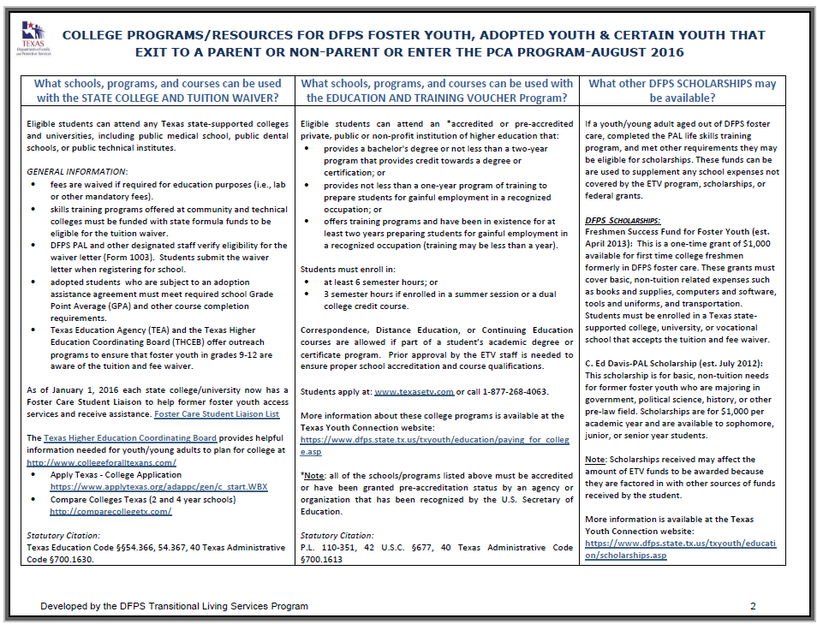
Be Aware of Benefits and Services
College Tuition and Fee Waiver- DFPS
Preparation for Adult Living Services (PALS)- DFPS
Educational Training Voucher (ETV)- BCFS
Lifeworks
Workforce Solutions
Medicaid STAR
Education Reach for Texas

Slide 5
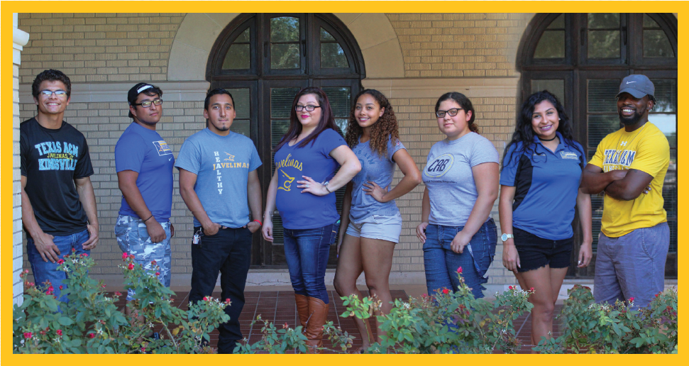
Identify Your Students
Texas Common Application
Tuition and Fee Waiver

Slide 6
Establish A Student Organization
Determine the group purpose and goals
Office of Student Activities
Advocacy
Faculty-Staff-Peer Mentoring
Scholarships- Financial Aid
Book Library- Donation Drive
Academic Coaching/tutoring
Career Services
Counseling Center
Financial Literacy
Resources to address food insecurity
Housing Support (if possible)

Slide 7
Strategies for Normalizing Group Identity
Student organization
Social events
Recognizing individual achievements
Community Service
Leadership Opportunities
Empowering students to tell their story
Group work and other experiential activities
Trauma Informed, Strengths-based ApproachTraining

Slide 8
Staying in Contact
Orientation Days
Newsletters/ Email
Monthly Organization Meetings
Starfish
Postcards

Slide 9
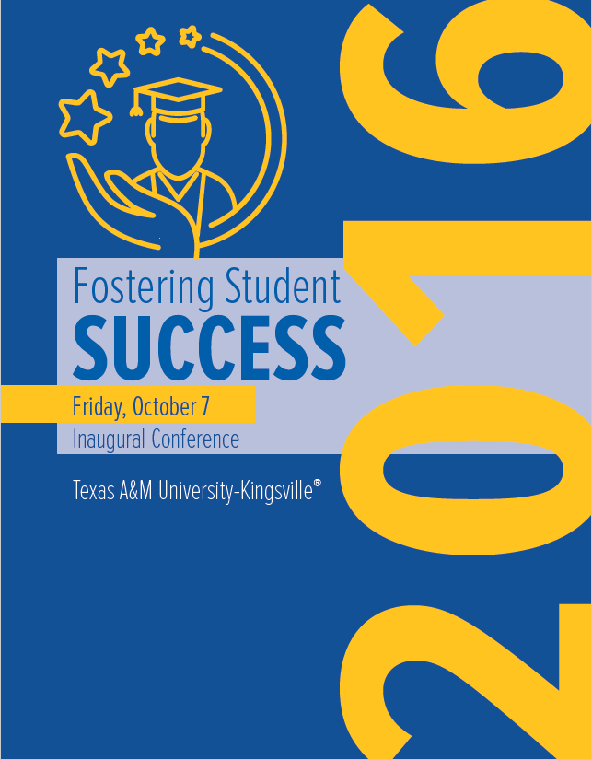
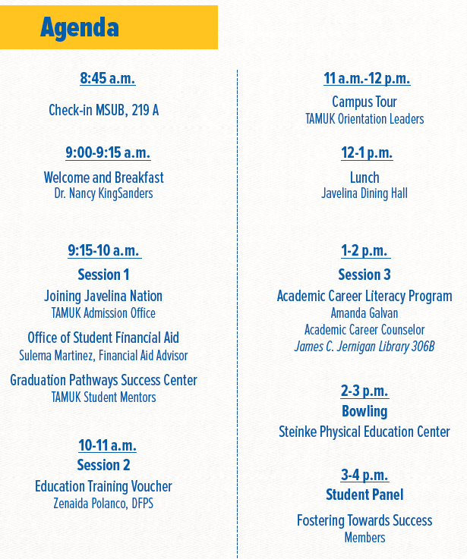
Fostering Student Success Conference
To create a campus-wide network of support to assist students who grew up in the foster care system achieve educational success by focusing on recruitment, retention, and graduation.

Slide 10
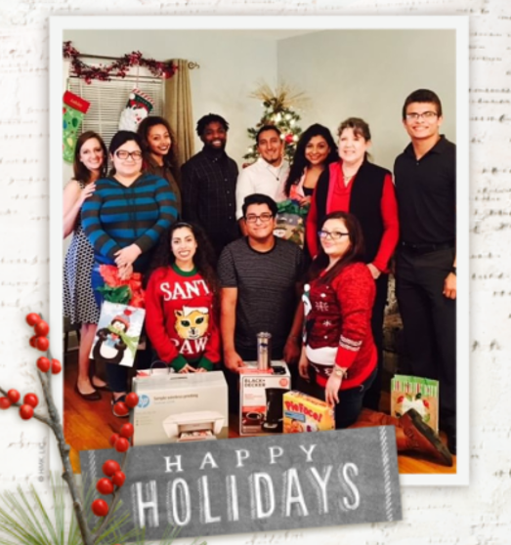
Event Participation
September- Fostering Student Success Conference
October- National Night Out/CPS Halloween Party/ Treat or Trunk (Athletics)
November- Thanksgiving Food Drive
December- Holiday Gathering
March- Bigger Event/Spring Fling
April- Child Abuse Awareness Month
May- End of the Year BBQ

Slide 11
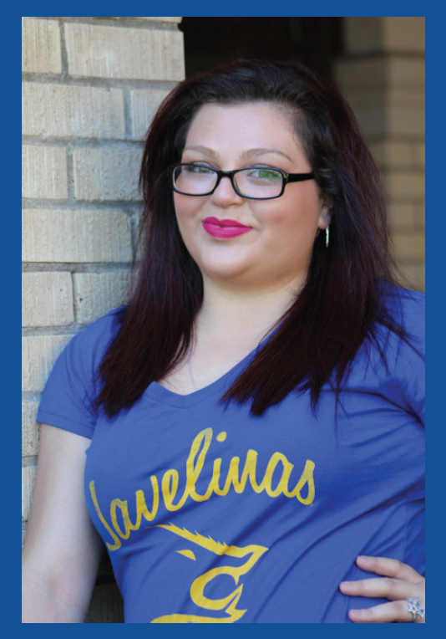
Monthly Meetings
Academic Updates
Financial Updates
Media Updates
Dinner
Donations
Speaker
FTS Members choices
Community Member

Slide 12
