Slide 1


The Fostering Success Coaching Model
Jamie Bennett, MSW
Training Specialist
Center for Fostering Success
Western Michigan University
Notes:
This video will provide information about the history of the Fostering Success Coaching model, and reasons for using a coaching approach with college students who have experienced foster care.

Slide 2
Fostering Success Coaching:
History
Developed by
  Partnering with students who are experts of the lived foster care experience.
  Learning from the subjective experiences of college students who aged out.
  Grounding understanding of student experiences in theory and research; refine it by internal program evaluation; and, shape it by clinical-level scrutiny.
The FS Coach Model is a research-informed, trauma-aware, skill-based practical model.
Notes:
The Fostering Success Coaching Model is a model of practice that equips professional with tools to support and promote thriving with students from foster care in various post-secondary educational settings. The Fostering Success Coaching Model was developed over the course of several years within the Seita Scholars Program at Western Michigan University. The Seita Scholars Program in a comprehensive support program for students who have experienced foster care. During the model development Traditional ideas and models for providing support were suspended, so that the Seita Scholars staff could learn from the students and incorporate new learning and ideas in an effort to create a responsive model of support. This learning was achieved through an intentional partnering with students and a consistent viewpoint that the student was the expert of their experience, needs and goals. Over time, coaches practiced partnership, and learned from the students what worked and what did not work, resulting in the emergence of the Fostering Success Coaching Model. This learning was further cemented by grounding ideas and practice in sound theory and research, refined over time using internal evaluation.

Slide 3
Why Coaching?
Coaching provides students from foster care a perspective different from other roles (e.g., casework, therapist, guardian).
Foster care experiences can result in
  Exposure gaps
  Habits to survive the system
Coaching focuses on
  Creating new experiences
  Integration at individual, interpersonal and system levels
  New habits to engage and thrive in college
Notes:
Why use a coaching approach? Students aging out of the foster care system and entering the higher education system have likely experienced high numbers of different professionals over a period of time, including caseworkers, therapists and judges. . The coaching role was developed in an effort to provide a normative experience for students by creating a new role that wasn’t familiar or experienced while in foster care. Coaching allows the student to differentiate the campus support role from other professional roles experienced while in foster care.
The experience of foster care results in what can be called exposure gaps. Exposure gaps are different from remedial gaps, and do not indicate that students are behind and need to catch up. Students taught the developers of the coaching model early on that it wasn’t about having the capacity to learn, but rather the opportunity. Exposure gaps are filled by new experiences.
Further, a sense of Disintegration results from the experience of moving between schools, homes, caseworkers, therapists. Students arrive at college with many pieces of life, but without a sense of those pieces of fitting together. There can also be a sense of survival, resulting of habits that include going it alone, not relying on others and not trusting others.
Coaching focuses on creating new experiences, and integration on three levels. First, on an intrapersonal level, coaching creates experiences that give the student a chance to make sense of memories, experiences and who they are so that the pieces can come together in a sense of identity. Interpersonal integration includes helping a student to make sense of the people in their lives, and how they fit together to form a support network. On a system level, integration includes making sense of systems including health care, education, mental health, foster care services. Lastly, coaching focuses on new habits versus a problem centered viewpoint of behavior.

Slide 4
Problem solving
Critical thinking
Asking for help
Coping strategies
Communi-cation skills
Relation-ship skills
Identity Dev.
Exposure Gaps
Opportunity to fail safely
Knowledge and Skill Development
Consistent schooling
Consistent housing
Safe environment
Consistent parenting
Growth opportunities

Slide 5
Exposure Gaps
Problem solving
Critical thinking
Asking for help
Coping strategies
Communi-cation skills
Relation-ship skills
Identity Dev.
Foster Care Experience
Failing means danger
Multiple school Changes
Unsafe environment/
trauma
Homelessness
Growth seen as dysfunction/
mental illness
Multiple placements
Disrupted relationships

Slide 6
Exposure Gaps
Problem solving
Critical thinking
Asking for help
Coping strategies
Communi-cation skills
Relation-ship skills
Identity Dev.
Foster Care Experience
Failing means danger
Multiple school Changes
Unsafe environment/
trauma
Homelessness
Growth seen as dysfunction/
mental illness
Multiple placements
Disrupted relationships
Notes:
Arrow represents the opportunity for relationship to create experiences to bridge the exposure gap. For example, going to the grocery store with a student provides the opportunity to learn skills such as: budgeting, meal planning, nutrition and health habits, food storage and prep. Also, planning ahead,

Slide 7
Student Challenges Addressed with Coach
 | Percent
Active Biological Family Issues | 33%
Depression or Anxiety Interfering with School | 29%
Academically Unprepared | 27%
Concern for Siblings Adopted or in Foster Care | 23%
Physical Health Problems | 17%
Death or Violence of a Loved One | 16%
Police Involvement | 13%
Substance Abuse | 13%
Domestic or Physical Violence involving Student | 10%
Mental Health Diagnosis | 9%
Pregnancy or Parenting | 7%
Suicide Ideation or Attempt | 6%
Documented Learning Disability | 3%
Notes:
The Fostering Success Coaching Model responds to the need to support students academically while also addressing other needs that arise that can interfere with success in school. This chart represents the results of an informal survey of coaches within the Seita Scholars Program in 2010. Each coach identified current situations and challenges that their students were facing. What became clear was that family issues, mental health disruptions, and academic unpreparedness were real things students were facing each day. This awareness allowed the coaching model to move towards a comprehensive, holistic model for support, focusing on more than just academic support.

Slide 8

How is Coaching Different?
Present and future focus
Priority on outcomes, goals and thriving
Focus on partnership and relationship
Promotes skill development and accountability

Slide 9

Student Success Addressed with Campus
Academic Success
Strong Desire to Give Back
Ease in Adapting to New Settings
Willingness to Create New
Community in College
Creating and Repairing Family
Relationships
Resilience and Determination
Notes:
Equally important in the evolution of the FS Coaching model were the strengths and success that student’s brought to college. With coaching support, many students thrived in their chosen major; a normative experience created space for the students to create community and new relationships, and begin to give back to their communities and other young people still in care. The willingness of students to provide direct honest feedback during the development of the model has directly affected all components of the model. Coaches using the model use each student’s strengths as a starting point to address challenges and coping habits that may be detrimental to academic success.

Slide 10
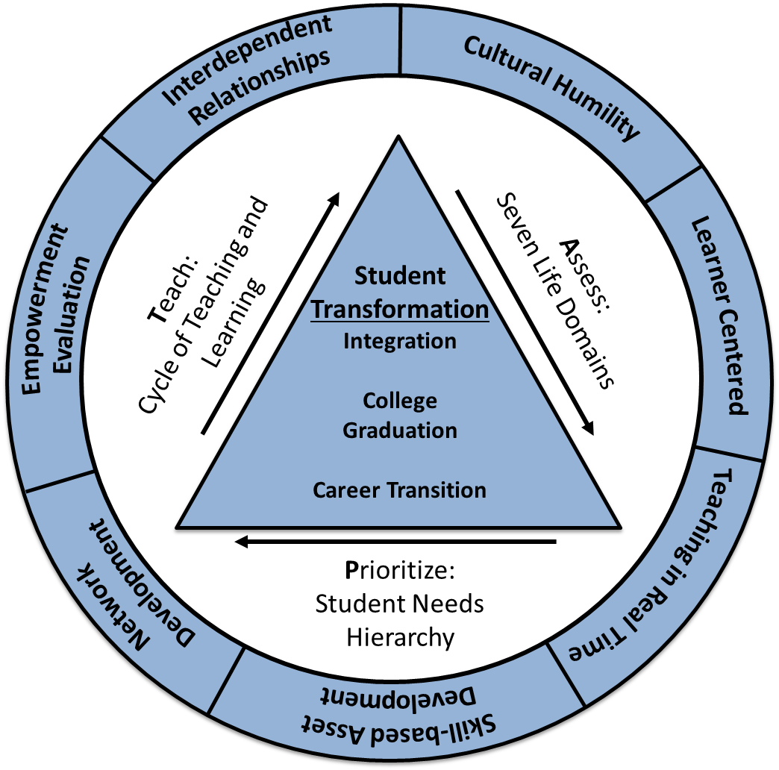
Fostering Success Coach Model
7 Core Elements
~ Philosophy
of Action
3 Practice Steps
~ Coaching Interaction
1 Goal
~ Transformation
Notes:
The Fostering Success Coaching model provides professionals a practice framework as well as practical student engagement strategies uniquely designed to address students’ actions (and inactions) while giving consideration to a childhood of ACEs and the expectations of college and career.
Pictured here is the Fostering Success Coaching Model. This conceptual framework illustrates the components of the model, including 7 core elements which provide a philosophy of action and provide the theoretical underpinnings of the Coaching Model. Also included are the three practice steps, which when executed collectively make a full coaching interaction. In the center the goal of coaching is displayed, which is transformation, achieved by integration, college graduation and career transition.

Slide 11
Coaching Core Elements
4. Teaching in Real Time
Teach “live” and ongoing
5. Skill-based Asset Development
Name, describe, practice and generalize skills
6. Network Development
Build social & career networks
7. Empowerment Evaluation
Student feedback
Data driven decision-making
1. Interdependent Relationships
Partnership
Reciprocal transformation
2. Cultural Humility
Intersection of life “roles”
with foster care “culture”
Acknowledge power dynamics
3. Learner Centered
Tolerance for mistakes
Process vs. content driven
Notes:
IR: are core to the model, and drive the partnered relationship between the coach and student. Reciprocal transformation refers to the exchange of expertise between coach and student. The student teaches the coach about their experience, strengths, needs and goals, while the coach acts as an expert on how to thrive in college and beyond given the student’s experiences. The coach and student mutually rely on each other for transformation, which can not be achieved if one or the other is not present.
CH: is very important in helping young people establish a sense of self. It Allows for the notion that foster care is a culture in itself, and names this as a means of allowing a student to include this it exploring who they are in the context of other cultural aspects, including race, sexual orientation, socioeconomic status, gender and ethnicity. CH also acknowledges power dynamics, putting on the table that a staff member might have certain powers that students do not, and invites discussion on how to navigate that within the relationship.
LC: Asks how does a student learn. It includes tolerance for mistakes in learning based on development. Focus is on process versus content, which means listening to and honoring the content, but also listening for patterns of behavior, thinking and learning that contribute to or hinder the student’s success.
TIRT: is about teaching in the moment, within the context of the student’s lives. TIRT also means that teaching can happen in various modes of communication, including face to face, phone, email, or texting.
SBAD: Focus of teaching skills that can be labeled and generalized in many areas of the student's life. This core element values skills practice, role plays, and moving past just giving information to a student.
ND: Emphsizes the need to have a solid professional and personal network. This is always being reinforced in the student coach relationship. ND is also includes system level network devlopment on the coach’s behalf, meaning the coach having a network that can be tapped into by the student as well for comprehensive support.
EE: Producing feeback loops with students in order to refine our practice to reinforce strengths and address student challenges.

Slide 12
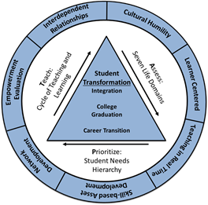
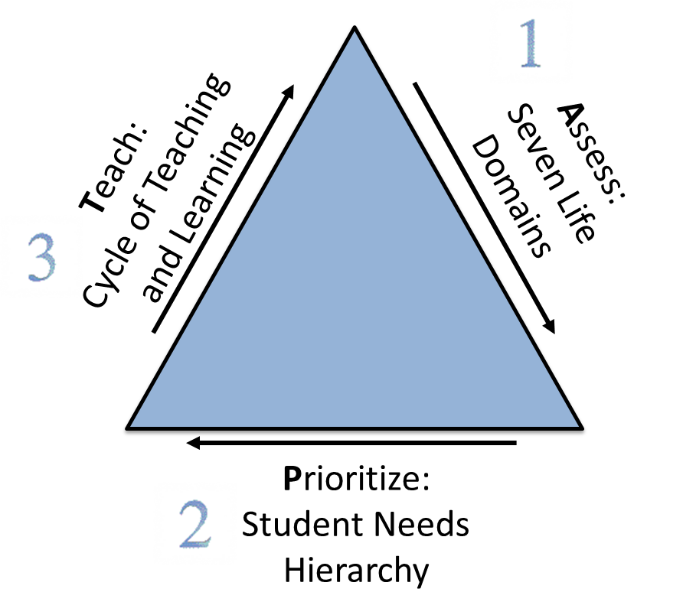
Three Practice Steps
The Coaching Interaction
Notes:
As we move towards the center of the model, the practice steps are represented around the three sides of the triangle. This is the heart of what happens between a student and coach. This interaction can vary in in time from 5 minutes to one hour, to longer. The first step is Assess, and the coaching tool used to assess is the Seven Life Domains. Second, the coach prioritizes using the student needs hierarchy, and lastly, the coach teaches uses the cycle of teaching and learning.

Slide 13
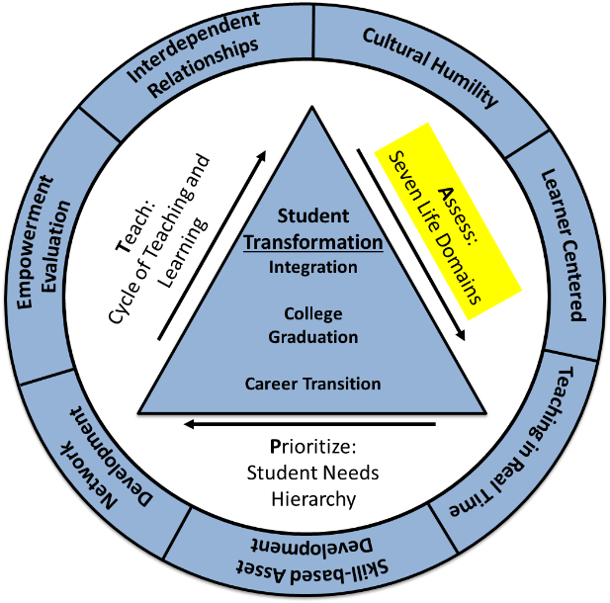
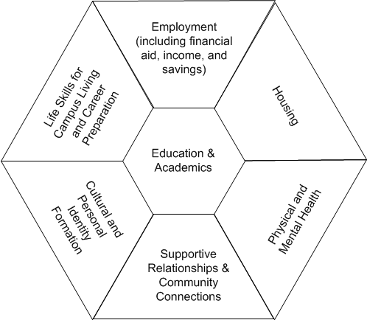
Assess:
Seven Life Domains
Adapted from: Casey Family Programs (2001). It’s My Life. Seattle, WA: Author
Notes:
First, the coach uses specific skills to assess the challenges and strengths present for the student using the Seven Life Domains, which come from Casey Family Programs research. This first step is done in partnership with the student, holding the value that the student is the expert of their life. In this step, problem solving or prioritizing are not included. The coach and student are simply exploring with curiosity and categorizing. Therefore, assessment simply allows the coach and student to have a birds-eye view of the landscape of a student’s life versus moving towards making any decisions about what to do about it.
Let’s say for example, Sarah, a college student, comes in for a meeting with her coach. Sarah’s coach may begin the assessment by asking, “What are the highlights and lowlights of your week?”, or “Can you choose the top three domains that have been best for you and the top three domains that have presented some challenges for you this week?” In response to these questions, Sarah and her coach determine that Sarah is thriving in the relationship, health and housing domains, but is having some challenges in the academic and finance domains around a situation that includes Sarah not having enough money to buy her books for the semester. Now that the coach and student have assessed, they move to the next step of the coaching interaction, which is prioritizing.

Slide 14
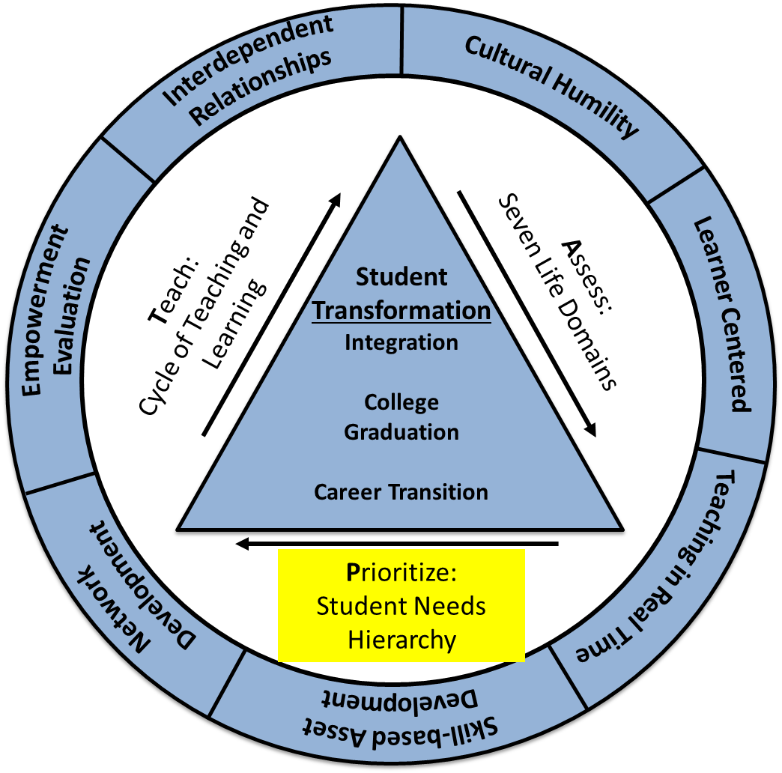
Prioritize: Student Needs Hierarchy
Adapted from: Maslow’s Hierarchy
Notes:
In the prioritizing step, the coach and student use the Student Need’s Hierarchy, modified from the traditional Maslow’s Hierarchy, to decide where to focus the rest of the coaching intervention by determining the student’s level of need. Basic living needs, located at the bottom of the triangle, is the starting point. If the student’s challenges do not fall in this area, then the coach and student move up the triangle towards personal and academic safety, belonging, and so on towards graduation. This type of prioritizing allows the coach and student to focus the coaching interaction, and effectively tackle the most important issues the student is facing in that moment. Reducing system stress resides outside the hierarchy, and speaks to the need for a coach to also be mindful and action oriented to any system barriers that present undue challenges for students.
Let’s come back to Sarah and her Coach. In the assessment phase, they decided that academics and finances were the domains that presented the most challenges, specifically because Sarah did not have the money to buy books for the semester. In prioritizing, the coach may ask Sarah to place her book situation on the needs hierarchy. Sarah decides that she falls in the level of personal and academics safety, because without her books she may not be able to do well in her classes, therefore jeopardizing her academic safety. Sarah’s coach agrees with this prioritizing. When assessing and prioritizing are complete, the coach can move towards the third step, which is teaching.

Slide 15
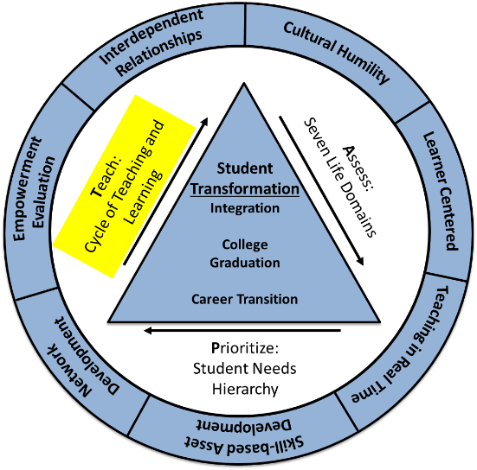
Teach: Cycle of Teaching
& Learning
Notes:
The last step of the coaching interaction involves implementing an intervention based on the assessing and prioritizing work that has been completed in partnership with the student. First, the coach decides if a student needs knowledge to help move forward, awareness to move forward, or a new skill to move forward. Upon deciding this target, the coach then decides which specific intervention will be applied to meet this target. Steps 3 and 4 of the Cycle of Teaching and Learning ask the coach to determine how progress will be noted, and what the next steps based on the progress. The cycle is iterative, and may be repeated more than once in a coaching interaction.
Let’s see how Sarah and her coach may use the cycle of teaching and learning given her book situation. If the coach determines that Sarah is missing a piece of information that could help, such as information about a financial resource that has been untapped, the coach may give her a handout or written resource with the information. If the coach decides that Sarah may benefit from awareness about how her spending habits are resulting in shortages for needed school supplies, he may engage Sarah in doing a budget to increase her awareness of spending. The coach might decide that a new skill could help Sarah move forward in this situation, such as accessing academic resources, upon which he may use a teaching strategy to help her learn the skill. As the coach moves into steps 3 and 4 of the cycle, he will ask himself what what will indicate progress for Sarah. If he decides to teach Sarah the skill of accessing resources, he would expect Sarah to have her books within the week. If Sarah does not make this progress, her coach will begin back at the top of the cycle, repeating the steps again with an alternate target and intervention.

Slide 16
Fostering Success Coach Model
7 Core Elements
~ Philosophy
of Action
3 Practice Steps
~ Coaching Interaction
1 Goal
~ Transformation
Notes:
The Fostering Success Coaching model provides professionals a practice framework as well as practical student engagement strategies uniquely designed to address students’ actions (and inactions) while giving consideration to a childhood of ACEs and the expectations of college and career.
Pictured here is the Fostering Success Coaching Model. This conceptual framework illustrates the components of the model, including 7 core elements which provide a philosophy of action and provide the theoretical underpinnings of the Coaching Model. Also included are the three practice steps, which when executed collectively make a full coaching interaction. In the center the goal of coaching is displayed, which is transformation, achieved by integration, college graduation and career transition.

Slide 17
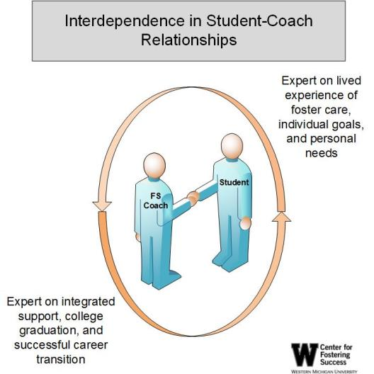
The Student – Coach Partnership
Authority is balanced
Student’s needs, wants and goals are priority
Lead with doing with,
rather than doing for or to
Interdependence
Notes:
Because the coaching relationship is time limited, there is a need for the student to learn to self-coach, meaning that the student learns the steps of the coaching interaction. By intentionally promoting partnership, the coach teaches the student the steps of the coaching interaction. As a student becomes more skilled with the steps of the coaching interaction, they can begin to self-coach, therefore using the coaching relationship to fill in gaps or consult on the steps they have already taken.
For example, in her senior year and faced with the same financial situation of not being able to buy books, Sarah might call her coach and say, “I was having some difficulties financially, which meant I couldn’t buy books. I know that was risking my academic safety, so I managed to get all but one from the library for the semester. I still need one though. Do you know of any resources that can help me find that last book?” In this example, Sarah assessed, prioritized (Finances, academics, academic safety) and successfully implemented an intervention of accessing resources through the library. She is now using the coaching relationship to fill in the last blank she is having some trouble with.

Slide 18
Transfer of Coaching Skills
Students learn to self-coach
Professionals (i.e., coaches) build their coaching capacity through real-time needs presented by students
Once taught, the coaching interaction can be applied in 5 minutes or less
  High frequency, brief duration is ideal
Coaching interactions can bring consistency to student communications with multiple professionals, common language
Notes:
When the coach and student partner, there is a mutual transformation that can happen. Students learn valuable skills to move through successes and times of stress for the rest of their lives through self-coaching. The coach’s capacity to coach increases as they build their understanding and practice based on student’s real-time challenges and success. Once familiar to the student, the interaction can be brief. Coaching interactions in the Fostering Success Coaching Model are intended to be high frequency and low duration, meaning that coaches interact with students often, and those interactions do not have to be lengthy. If you have more than one coach available to work with students, The coaching model allows for a student to receive consistent coaching from any coach they encounter, which reinforces new habits and skills.

Slide 19
Improving Educational Outcomes*
3rd Semester Retention Rate
% of Student Returning
Year of Student Cohort
* Fostering Success Coaching also monitors student outcomes in other life domains: finances, housing, health, relationships, identity and life skills
Notes:
Early data shows that the Fostering Success Coaching model is producing success and student retention at WMU. In 2008, the students from foster care at WMU were retained, meaning they returned for a second year, at a rate of 46%, which was below the school’s average. This was a year in which coaching and coaches were not in place. When coaching began in 2009, retention began to rise, and has maintained on pace with the general university retention.

Slide 20
The Fostering Success Coaching Model
Fostering Success Coach Training
Notes:
This video will provide information about the Fostering Success Coach Training and Certification.

Slide 21
Fostering Success Coach Training
Notes:
The Fostering Success Coach Training and Certification was developed in an effort to teach professionals the Fostering Success Coaching Model. Training provides intense skill development, and effectively equips professionals with practical tools to partner with students. It also provides a network of other coaches to learn from and with, and expert consultation opportunities. There are three levels to the Training and Certification process.

Slide 22
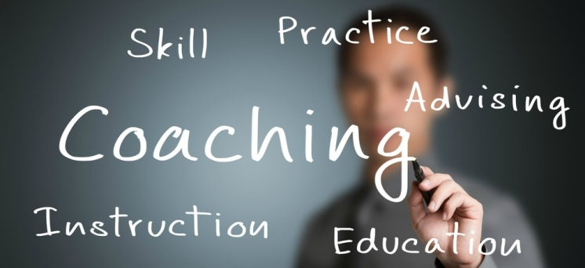
Fostering Success Coach:
Level I
This beginning level introduces the core and practice elements, with an emphasis on applying practice skills.
Notes:
This beginning level introduces the seven core elements and three practice elements, which make up the core infrastructure of the Fostering Success Coach Model. Level I training focuses on building a strong conceptual foundation for working with youth, and provides basic practice skill set for working with students from foster care. Highlights include:
Learn the 7 Core Elements of the Fostering Success Coaching Model philosophy of action: interdependent relationships, cultural humility, learner centered, teaching in real time, skill-based assets, network development, empowerment evaluation
Learn the 3 Practice Steps of the Fostering Success Coaching Model, which make up a coaching interaction: Assessment, Prioritize, Teach
Learn basic coaching skills that help students thrive in education and career development.

Slide 23

Fostering Success Coach: Level II
This intermediate level introduces advanced practice skills, with an emphasis on developing critical application of practice skills
Notes:
This intermediate level introduces advanced practice skills, and emphasizes building competency in applying the Fostering Success Coaching Model to challenges of persistent or crisis nature and presented by students and systems. Highlights include:
Learn how to apply the Fostering Success Coaching Model to scenarios involving student crisis and conflict and system inequities.
Learn how to use coaching data to inform incremental skill building with students and professional development as a coach.
Learn the Fostering Success Coaching Model Intervention Review method for systematic reflection of coaching interactions with students.
Learn strategies to improve institutional systems of student support.
Learn intermediate coaching skills that help students thrive in education and career development.

Slide 24
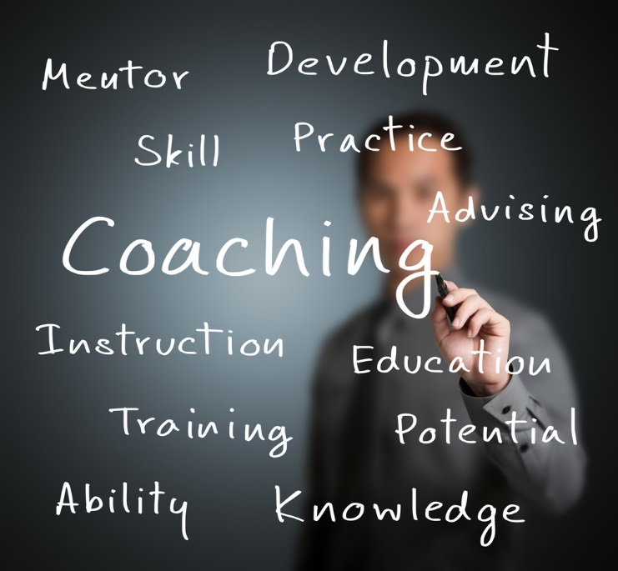
Fostering Success Coach: Trainer
This level incorporates a train the trainer approach, teaching the Level I and II material for training, supervision and supervision purposes.
Notes:
This level incorporates a train the trainer approach, teaching the Level I and II material for training, supervision, and consulting purposes with beginning and intermediate coaches. Highlights include:
Learn to use the Fostering Success Coaching Supervision model with individuals who have completed Level I and II trainings.
Learn how to train the Fostering Success Coach Training curriculum at Levels I and II.

Slide 25
For more information about the Fostering Success Coaching Model and the Fostering Success Coach Training:
cfs-coaching@wmich.edu
(269) 387-8384
www.wmich.edu/fosteringsuccess/
outreach/training

