Slide 1
Higher Education Outcomes of Youth Formerly in Foster Care in Texas: Exploring the Impact of Liaison Legislation and Campus Support Programs
Toni Watt, PhD
Texas State University
Department of Sociology

Slide 2
Acknowledgements-Many Thanks
Funding from the Greater Texas Foundation
Co-Authors: Sheila Bustillos, Kayli Lorde, Colin Pierson, Johanna Greeson, Toni Hail, Regina Gavin-Williams, & Angela Hoffman-Cooper
Foster Scholar Consultants and Research Assistants: Amber Alston, MacKenzie Fierceton, Liz Medina-Madrigal, Elizette Medina-Madrigal
Data provided by the Texas Higher Education Coordinating Board and the Texas Department of Family and Protective Services
Webinar hosted by Education Reach for Texans

Slide 3
Background
The majority of youth in foster care want to go to college-few achieve their dreams
Post-secondary Degree by age 24
National-2-3%
Texas-2-3%¹
General Population-33%

Slide 4
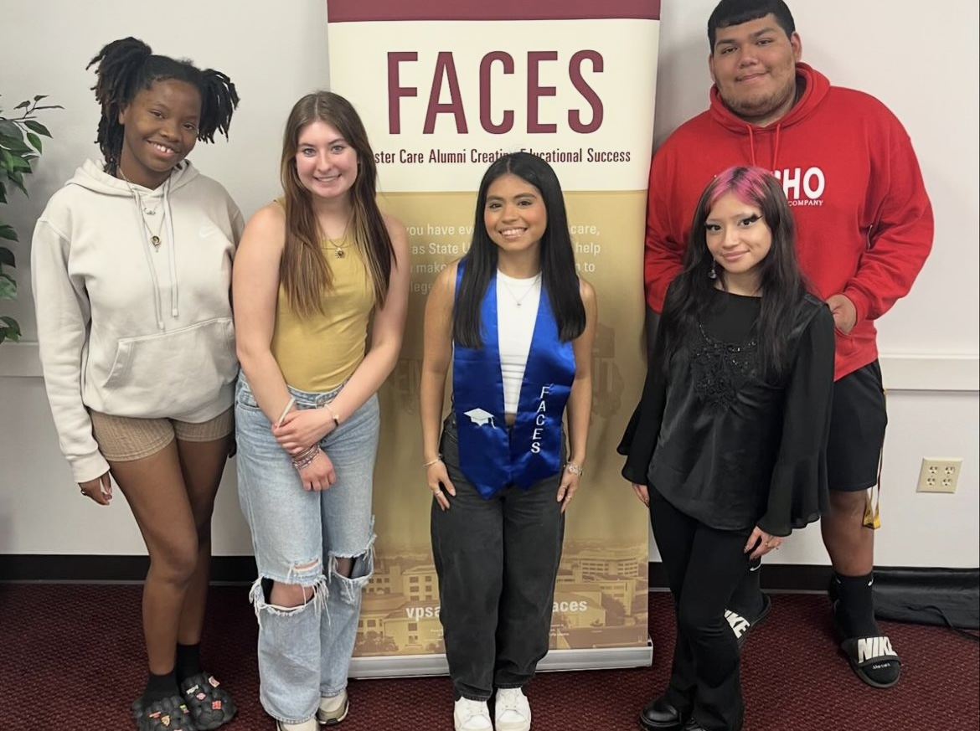
Background
Many states have programs/policies to improve SEFC outcomes
Texas
Tuition and fee waiver (1993)
Extended foster care (2009)
Liaison legislation in 2015 (HB 3782) and 2019 (HB 1702)
Unfunded mandate
Legislatively mandated data exchange-DFPS and THECB (2015)
Unfunded
Grassroots movement to develop campus support programs

Slide 5
Existing Literature-What Works?
Tuition and fee waiver²
SEFC who use the waiver-3.5x more likely to receive a degree
40% of waiver eligible youth don’t use it
Extended foster care
Increased enrollment but not post-secondary outcomes³
Liaison legislation
Research on implementation-No Outcomes Yet⁴⁻⁵
Campus support programs
Some studies show improved outcomes with CSP participation.⁶ Other research shows no impact of CSPs.⁴

Slide 6
GTF Project: Evaluate Implementation and Impact of
Liaison Legislation and Campus Support in Texas
Primary data collected for Texas college campuses (2020)
In-Depth interviews with SEFC in college (n=8)
Content analysis of campus websites (n=113)
Liaison survey administered online in 2020 (58% response rate)
Primary data merged with DFPS/THECB Data from 2012-2021

Slide 7
Liaison Legislation:Validation of Need for Liaisons
SEFC want and value a key point of contact/liaison
“Often serving as a motivator, coach, organizer and connector of services, I think for me to have that kind of adult in your corner has been very instrumental in my success.”-SEFC
Some students didn’t know they had a liaison available
“No, I don’t have—I didn’t know what it was until you said anything.””-SEFC
“No, no one has reached out to me, I haven’t heard anything about it.”- SEFC
“I am totally alone”-SEFC

Slide 8
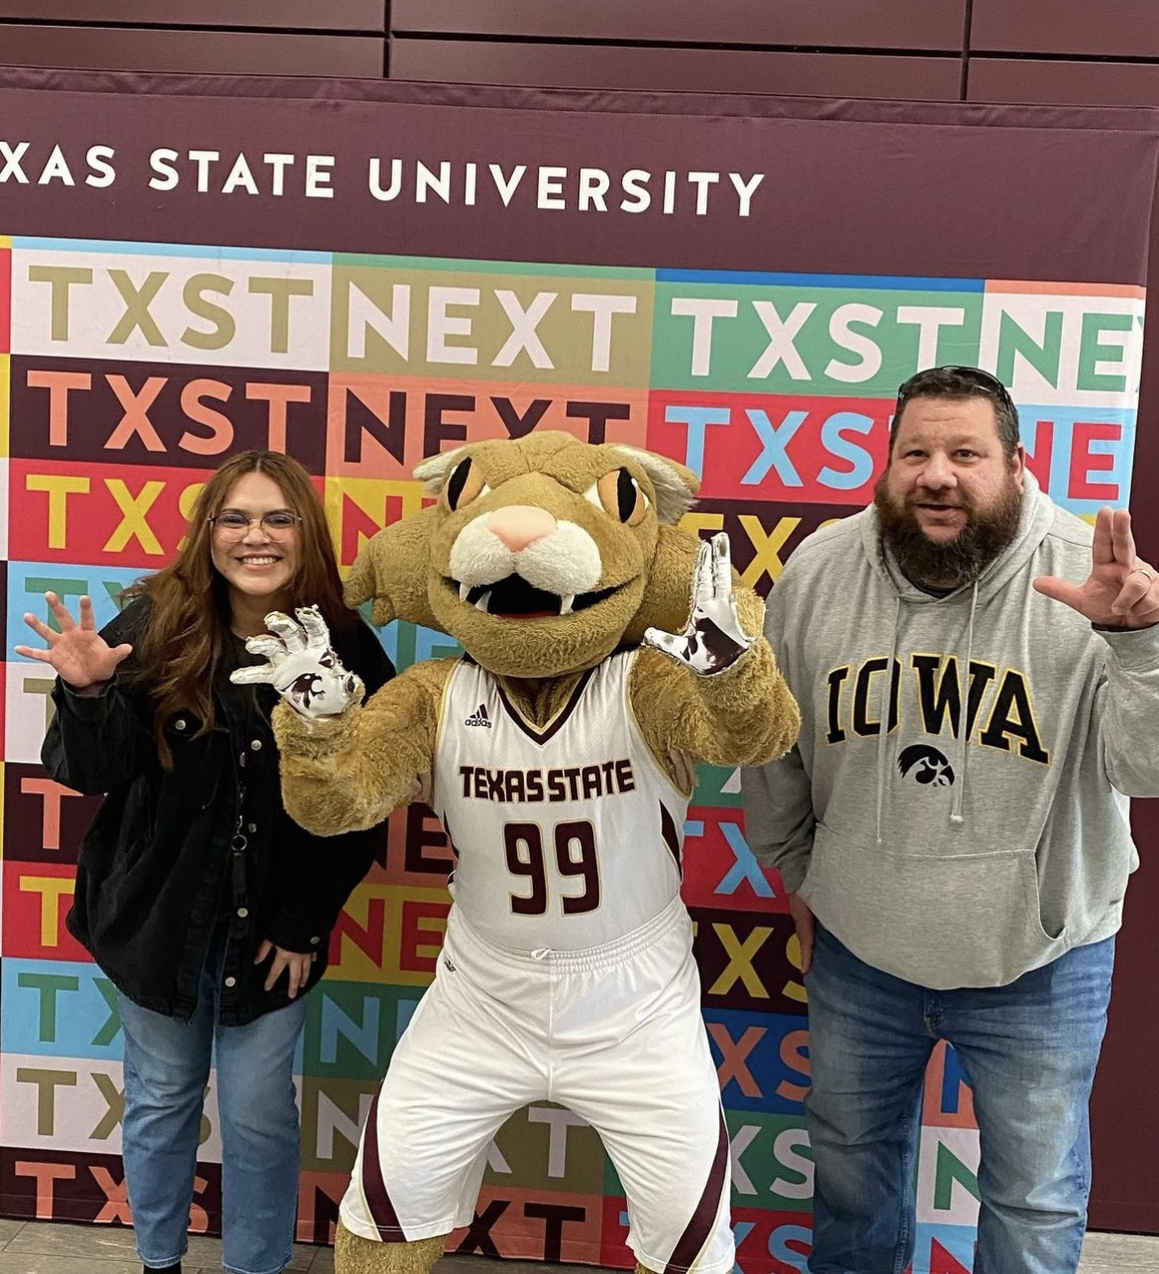
Liaison Legislation: Implementation
Half of campuses (49%) had not posted the liaison contact information
One-fourth of liaisons reported they don’t use any data source to identify SEFC

Slide 9
Liaison Legislation: Implementation
People for who wanted to be liaison and % that had their duties reduced
”needs to be a completely separate job instead of a side title”-SEFC Liaison
“All support is needed. I have no help and support at this”-SEFC Liaison
Notes:
88% wanted to be liaison; 7% had duties reduced

Slide 10
Liaison Legislation: Examining Outcomes over Time
Trend analysis of DFPS and THECB Data
Legislative timing (2015 and 2019)
Fall to Fall Retention (2012-2021)
Students who turned 18 and enrolled next year
First-time students of any age
Any students
Traditional Cohort

Slide 11
Notes:
SEFC that turned 18 year before and enrolled following year (traditional cohort)

Slide 12
Notes:
SEFC that turned 18 year before and enrolled following year (traditional cohort). National student clearinghouse research center national data

Slide 13
Notes:
SEFC that turned 18 year before and enrolled following year (traditional cohort)

Slide 14
SEFC Graduation Rates: Far Below the National Averages
Students First Enrolled
Four-Year Universities
SEFC-36%
Obtain a Bachelor’s Degree
National-62%
Obtain a Bachelor’s Degree
Students First Enrolled
Community Colleges
SEFC-21%
Obtain Post-Secondary Degree
14% get a Bachelors
7% get an Associates
National-43%
Obtain Post-Secondary Degree
15% get Bachelor’s
28% get Associates
Notes:
6 year completion rates for bachelors and 4 year completion rates for associates. Compared to National Student Clearinghouse research center. 2015 for bachelors and 2017 for associates. First time student of any age.

Slide 15
Evaluating Campus Support Programs-2020
Created measures of campus support from website analysis and liaison surveys
Measures were yes/no for:
Has a campus support program
Offer direct support or help accessing:
Financial Resources
Housing
Academic Support
Mental health services
Faculty/staff mentoring
Peer mentoring
Social relationships
Student organization

Slide 16
Campus Support and Retention Descriptives
 | % | n
Community College Yes No | 68.1 31.9 | 3189 1496
Four-Year University Yes No | 35.4 64.6 | 1660 3025
Campus Support Program Yes No | 58.8 41.2 | 2756 1929
Campus Support Program Elements Financial Assistance Housing Academics Faculty/Staff Mentoring Peer Mentoring Mental Health Social Relationships SEFC Student Organization | 68.4 36.1 58.2 25.4 12.3 49.5 29.2 20.4 | 3205 1689 2725 1188 576 2318 1368 956
SEFC Retention/Graduation 2020-2021 Yes No | 55.2 44.8 | 2099 2586

Slide 17
Is Retention Higher at Schools with CSPs?
Multivariate Regressions Predicting 2020-2021 Retention
Examined effect of having a CSP (yes/no) and CSP components
Control variables for age, gender, race/ethnicity, number of placements, % Pell grant recipients, mean spending on student services, and graduation rate
Generalized Linear Mixed Models
-to account for nesting of students in schools
Key Findings
Significant effect of CSPs at Four-Year Universities
Students attending four-year universities with CSPs had 41% higher odds of retention.
Mental health services was the only CSP component associated with improved outcomes
No effect of CSPs on Retention for CC

Slide 18
A Brief Summary
Liaison legislation did not increase retention rates for SEFC
Retention and graduation rates for SEFC remain low
Particularly for those pursuing an Associate’s degree
CSPs increased retention by 41% at four-year institutions
CSPs did not increase retention at community colleges

Slide 19
Limitations
Data Considerations
Texas has no state funding for liaisons or CSPs-limits generalizability to other states
CSP measures are broad and self report
Pandemic

Slide 20
Conclusions
With support, SEFC can achieve their higher education goals
However, to be successful, programs and policies require:
Funding
Staff training
Evaluation

Slide 21
Future Research-Need to Drill Down
Identify SEFC
|
|
Engage SEFC
|
|
Impact SEFC

Slide 22
Future Research
Future Research
Florida liaison evaluation (OPPAGA)
Moody Foundation Grant-
Peer Support Pilot
Reach and UNT-Dr. Sheila Bustillos (PI)
Bexar County Evaluation
BCFES Program-Dr. Megan Piel (PI)
Hopefully, many other evaluations

Slide 23
References
Watt, T., Faulkner, M., Bustillos, S., Madden, E. (2018). Foster Care Alumni and Higher Education: A Descriptive Study of Post-Secondary Achievements of Foster Youth in Texas. Journal of Child and Adolescent Social Work, 36(4); 399-408.
Watt, T., & Faulkner, M. (2020). The Texas tuition and fee waiver program for youth who have experienced foster care: An assessment of waiver utilization and impact. Children and Youth Services Review, 117, 105285.
Okpych, N. J., & Courtney, M. E. (2020). The relationship between extended foster care and college outcomes for foster care alumni. Journal of public child welfare, 14(2), 254-276.
Office of Program Policy Analysis and Government Accountability. 2022. OPPAGA Report. Homeless and Foster Youth Services. Report 22-08. Tallahassee, FL. December, p. 1-49.
Watt, T., Lord, K., Bustillos, S., Gavin-Williams, R., Greeson, J., Hail, T., & Hoffman-Cooper, A. (2023). Campus liaisons for students who have experienced foster care: Lessons learned from Texas legislation. Children and Youth Services Review, 153, 107094.
Okpych, N. J., Park, S. E., Sayed, S., & Courtney, M. E. (2020). The roles of Campus-Support Programs (CSPs) and Education and Training Vouchers (ETVs) on college persistence for youth with foster care histories. Children and Youth Services Review, 111, 104891.

Slide 24
Toni Watt tw15@txstate.edu

