Slide 1
Roadmap to College
What Is The Importance of Self –Identifying?

Slide 2
The Roadmap to College
2.
Applications / Admissions
3.
Advising /
Counseling
1.
Identification
College
Student
4.
Support

Slide 3
Establish An Ally/Support System on Campus
Office of Student Support & Success System
  Advising / Counseling
  Admissions/Records
  Financial Aid
  OSD (Office for Students with Disabilities)
  Support Center
  Learning/Tutoring Lab
  Supplemental Instruction
  Bridge Programs

Slide 4
ROLE OF CAMPUS CHAMPION
Liaison for entering foster care alum
Collaborate & coordinate services (with & for students)
Educational planning
Ongoing support system for continuing alum students
Student outreach & follow-up contact
Referral for resources internal / external of college system
Assist with problem solving on presenting issues, i.e. financial aid, academic concerns, counseling, etc.

Slide 5
ACC Model: Foster Care Alumni Program
The Roadmap to College
HOPE
Determination
LEADERSHIP
GOALS
PLANNING
MENTORING
Support
Motivation

Slide 6

ACC Model: Foster Care Alumni Program
The Roadmap to College Process
Developed by: Sylvia Galvan Gonzalez, M.S., NCC, LPC-S, BCPC
Austin Community College
Foster Care Campus Champion

Slide 7



Slide 8
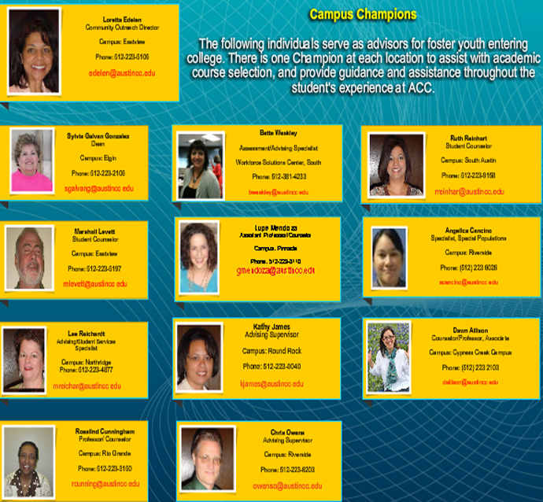

Slide 9
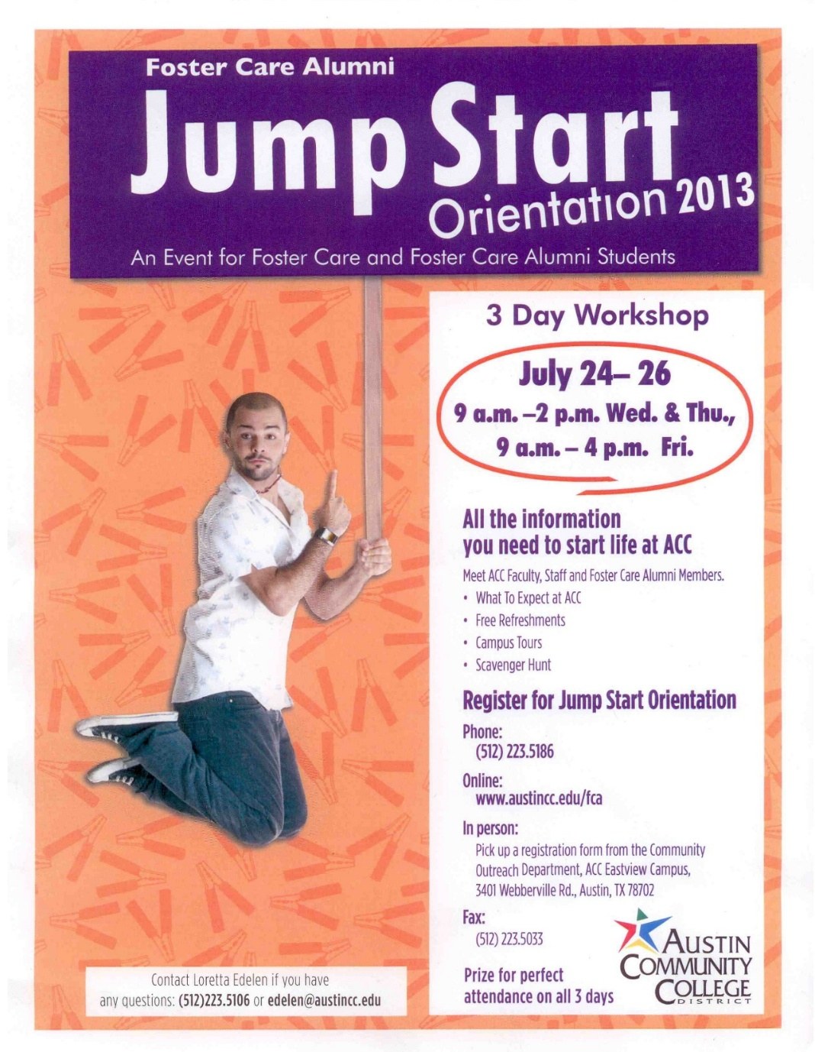

Slide 10
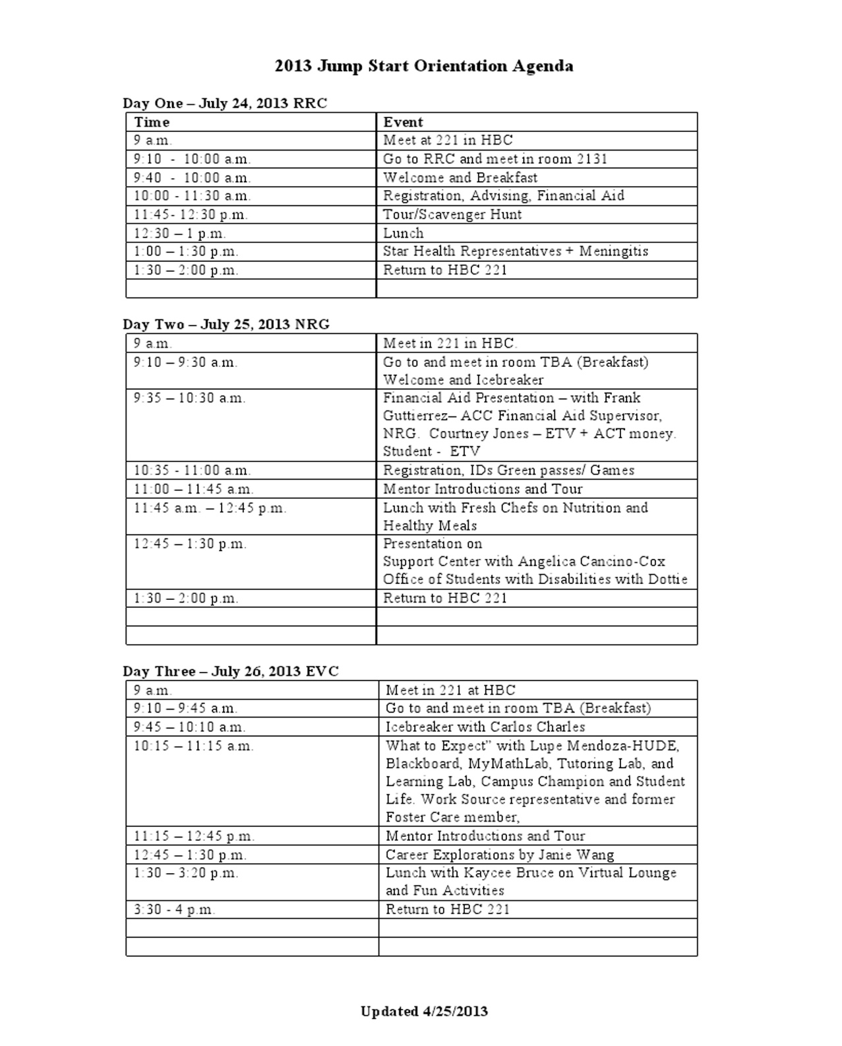

Slide 11


Slide 12
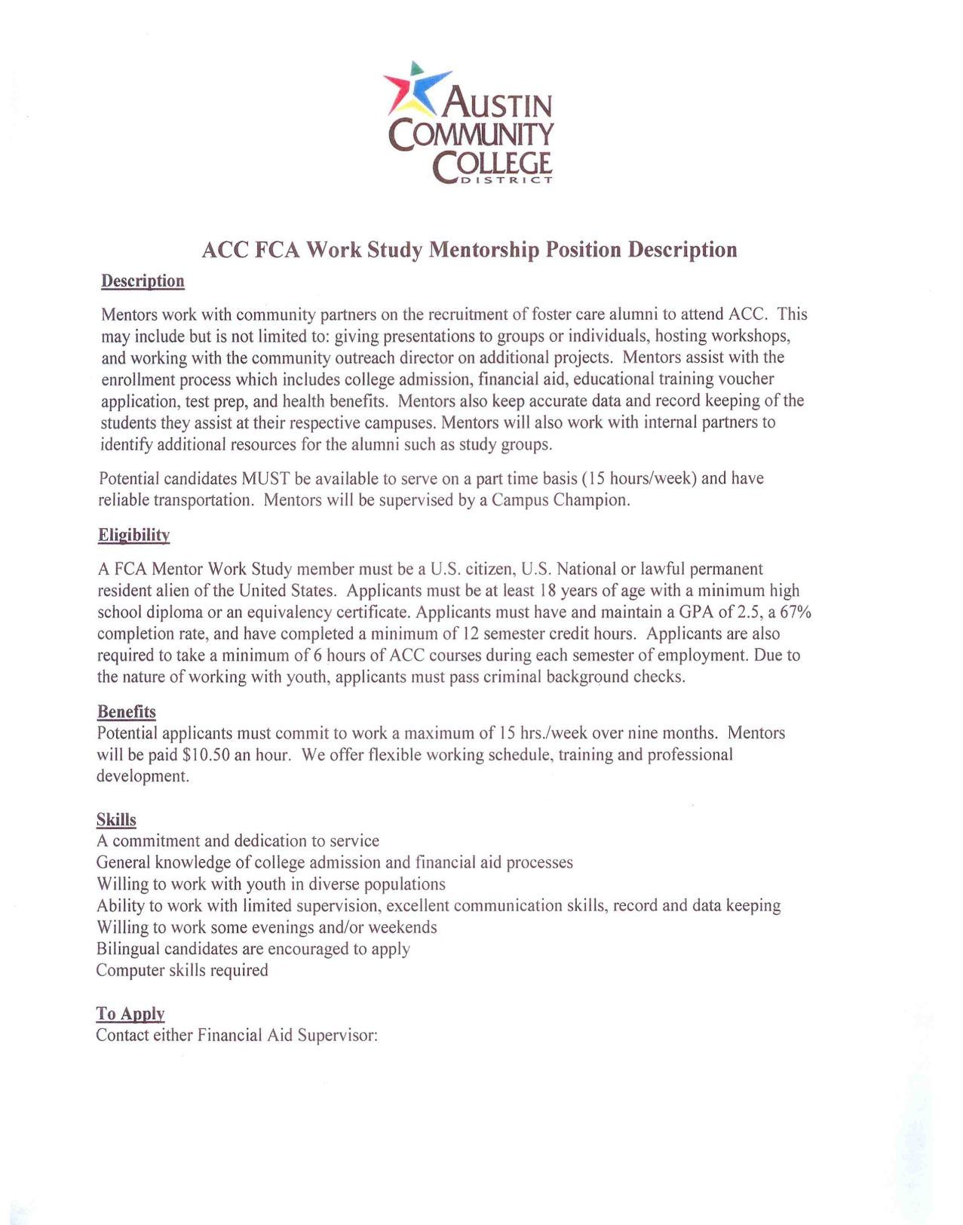

Slide 13


Slide 14
ACC Model: Foster Care Alumni Program
The Roadmap to College Process
References
Austin Community College (2008). Foster care alumni. Austin, TX: Foster Care Alumni Program Community Outreach.
Casey Family Programs (2008). Supporting success: Improving higher education outcomes for students from foster care. Seattle, WA: Casey Family Programs.
Hill, J. H. & Douthitt, D. (2006). True independence: How foster youth can go to college. Oklahoma University: Outreach National Resource Center for Youth Services.
Office for Students with Disabilities (OSD) (2002). Services for students with disabilities: Handbook of everything you need to know. Austin, TX: Austin Community College.

