Slide 1
SUPERVISED
independent

Slide 2
What is sil?
Who does it serve?
Young adults age 18 – 21 who are in Extended Foster Care (length of stay depends upon how they meet Extended Foster Care eligibility)
Who is eligible?
Young adults who are able to live independently with very little to no supervision
Follow extended foster care agreement
Young adults who want to return to care (must be before 21st birthday)

Slide 3
How sil differs from foster care
Receives an allowance for non-housing costs (i.e., food, hygiene, transportation)
Limited curfews
Must find own transportation
Own medical consenter so decides whether or not to continue medication, schedule other medical appointments, or attend therapy
No 24-hour supervision (supervision in some settings)
No restrictions on who they can and cannot visit with (some restrictions on where based on housing setting)
Cell phone provided if they come in without one (young adult responsible for paying this bill each month)

Slide 4
Goals of sil
Empower young adults
Teach responsibility while they have a safety net and support system
Learn how to live independently
Real-world teachings

Slide 5
SIL Basics
Referral Process (in care vs. return to care)
Assessment process and selecting the most appropriate setting
Movement through settings

Slide 6
CLIENT STRUGGLES
Handling the level of freedom
Completing tasks independently
Loneliness
Budgeting

Slide 7
CLIENT SUCCESSES
Getting critical documents needed for work and school
Finishing high school degree or GED
Enrolling in school
Saving enough money to purchase a car
Mentoring program

Slide 8
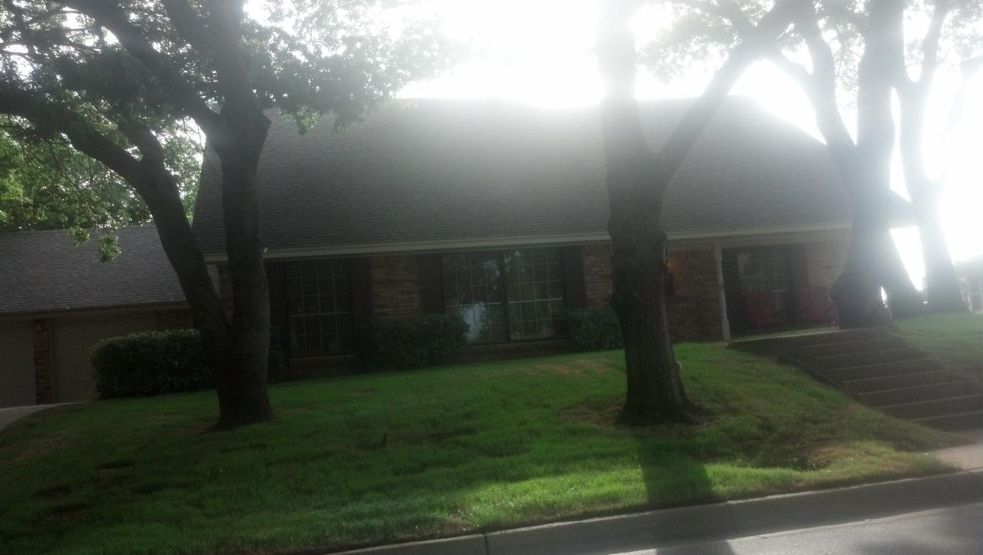
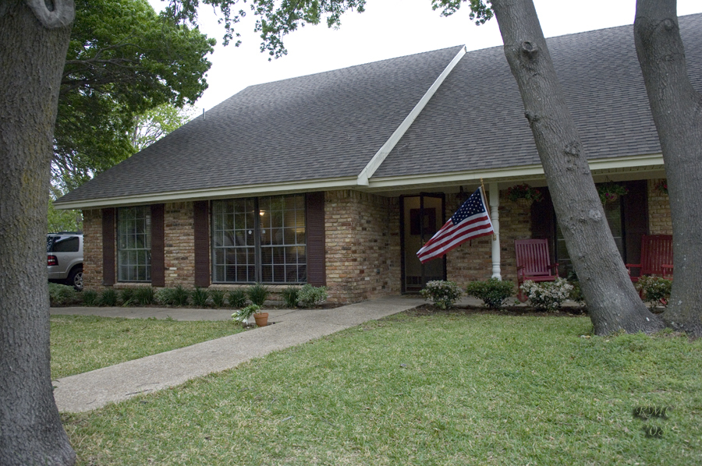
Shared housing

Slide 9
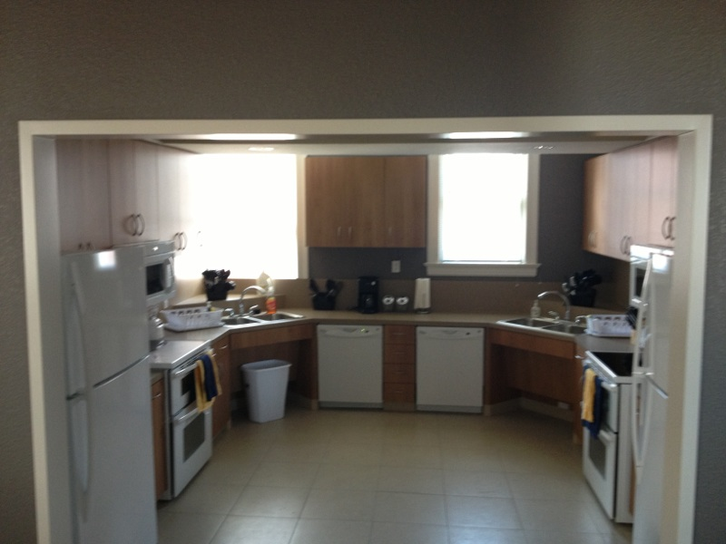
Non-college dorm
Kitchen

Slide 10
NON-COLLEGE DORM
COMMON AREA

Slide 11
NON-COLLEGE DORM
Boy’s bedroom

Slide 12
Families together
Bedroom

Slide 13
College dorms
Weatherford College
Navarro College
University of North Texas
Texas Woman’s University
Tarleton State University

Slide 14
Apartment settings
Ft. Worth
Corsicana
Mineral Wells
Irving
Mesquite
DeSoto
Dallas
Denton
Cleburne

Slide 15
Carla Storey, LCSW SENIOR Director of Residential Services 817.866.7128 direct dial 817.335.4043 fax
PSILPPT-1013

